Slide 1
Software Project Human Resource Management

Slide 2
Project Human Resource Management
Making the most effective use of the people involved with a project
Processes include
Human resource planning: identifying and documenting project roles, responsibilities, and reporting relationships
Acquiring the project team: getting the needed personnel assigned to and working on the project
Developing the project team: building individual and group skills to enhance project performance
Managing the project team: tracking team member performance, motivating team members, providing timely feedback, resolving issues and conflicts, and coordinating changes to help enhance project performance

Slide 3
Keys to Managing People
Psychologists and management theorists have devoted much research and thought to the field of managing people at work
Important areas related to project management include
motivation theories
influence and power
Effectiveness
Intrinsic motivation
causes people to participate in an activity for their own enjoyment
Extrinsic motivation
causes people to do something for a reward or to avoid a penalty

Slide 4
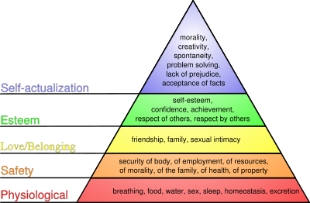
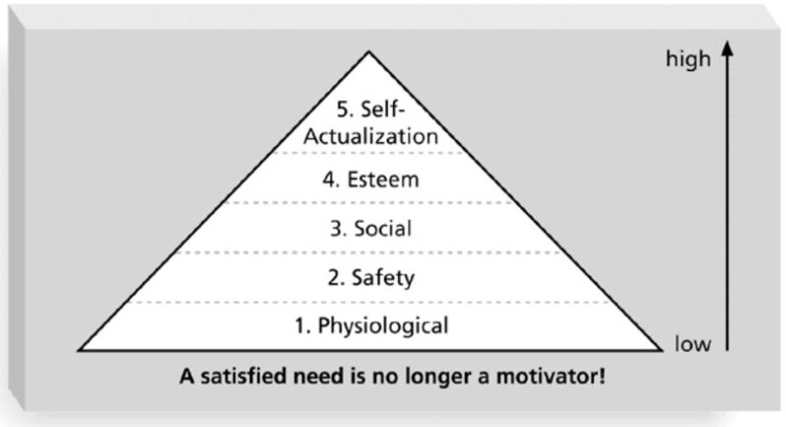
Maslow’s Hierarchy of Needs
Abraham Maslow – “humans possess unique qualities that enable them to make independent choices, thus giving them control of their destiny”
Maslow developed a hierarchy of needs which states that people’s behaviors are guided or motivated by a sequence of needs
Social

Slide 5
Herzberg’s Motivational and Hygiene Factors
Frederick Herzberg distinguished between
motivational factors:
achievement, recognition, the work itself, responsibility, advancement, and growth, which produce job satisfaction
hygiene factors:
cause dissatisfaction if not present, but do not motivate workers to do more.
Examples include salaries, more supervision, and work conditions etc.
Notes:
Satisfaction factors/ dissatisfaction factors
A motivation to buy a car was different then the things which dissatisfy you.

Slide 6
McClelland’s Acquired-Needs Theory
Specific needs are acquired or learned over time and shaped by life experiences, including:
Achievement:
Achievers like challenging projects with achievable goals and lots of feedback
Affiliation:
People with high affiliation desire harmonious relationships and need to feel accepted by others, so managers should try to create a cooperative work environment for them
Power:
People with a need for power desire either personal power (not good) or institutional power( good for the organization).
Provide institutional power seekers with management opportunities
Notes:
A human is feels motivated based on these three factors.

Slide 7
McGregor’s Theory X and Y
Douglas McGregor - 1960s
Theory X:
assumes workers dislike and avoid work, so managers must use pressure, threats and various control schemes to get workers to meet objectives
Theory Y:
assumes individuals consider work as natural as play or rest and enjoy the satisfaction of esteem and self-actualization needs
Theory Z:
introduced in 1981 by William Ouchi and is based on the Japanese approach to motivating workers, emphasizing trust, quality, collective decision making, reduce boss culture.
Notes:
X-people are lazy negative point of view
Y-people are committed to goal.
Mutual trust—job security-life time employment
Participation of employees in making decision
Competition

Slide 8
Ways to Influence that Help and Hurt Projects
Projects are more likely to succeed when project managers influence with
expertise
Projects are more likely to fail when project managers rely too heavily on
authority
penalty
Notes:
Inspire,affect

Slide 9
Power
Power is the potential ability to influence behavior to get people to do things they would not otherwise do
Types of power include
Coercive
Legitimate
Expert
Reward
Referent
Notes:
Coercive-use of force or threat

Slide 10
Coercive Power is often the least effective but most employed (and abused) type of power in the corporate world. Coercive Power is forcing someone to do something against their will or setting up “consequences” to employee actions.
Reward Power is another widely used method in business today. The results of Reward power are mixed and it is therefore the second weakest form of power. Reward Power is the concept of do this and get that. Or (said another way) if you do this, you will receive something in return.

Slide 11
Legitimate Power is in all organizations. Legitimate Power is the power of position or role. This is the typical “command and control” structure that is employed by the Military world.
Referent Power is the “cult of personality”.This is the power and ability for an individual to attract others and to build loyalty within them. Referent Power is also the power of respect. This can occur through time if a leader is successful and has a well known track-record of success.
Notes:
create a heroic image of a leader
Referent power is defined by trust. By its very nature, it is not something the leader can command of others, but rather something the leader earns on a case-by-case basis over time.

Slide 12
Informational Power is the newest addition to the types of power by French and Raven. Nonetheless, it is in the top 3 most effective types of power. Informational Power is the power of having information that another does not have.

Slide 13
Closely related to Informational Power,
Expert Power is when an individual possesses in-depth information, knowledge, or expertise in the area that they are responsible for. This type of power is often the most effective type of power.

Slide 14
Improving Effectiveness - Covey’s 7 Habits
Project managers can apply Covey’s 7 habits to improve effectiveness on projects
Be proactive
Begin with the end in mind
Put first things first
Think win/win
Seek first to understand, then to be understood
Synergize ( team work)
Sharpen the saw
Notes:
http://teamgantt.com/blog/2014/02/21/7-habits-of-highly-effective-project-managers/
Physical spiritual mental social
Successful productive

Slide 15
Empathic Listening and Rapport
Good project managers are empathic listeners - they listen with the intent to understand
Before you can communicate with others, you have to have rapport – a relation of harmony
Notes:
Rapport is a positive feeling about a relationship and is like a bridge between two islands. Stronger bridges can carry heavier trucks and lorries. When you have a stronger relationship with someone, you can ask more of them.

Slide 16
Resource Management
Matching the activity plan to available resources and if necessary change the plan to fit the resources
The result of resource allocation will normally be a number of schedules including:
Activity Schedule: indicating the plan start and completion dates for each activity
Resource schedule: showing the dates on which each resource will be required and the level of its requirement
Cost schedule: showing the cumulative expenditure incurred by the resource

Slide 17
What is Resource Allocation
The process of resource allocation
After the activities have been identified using various techniques and tabulated into a Work-Break-Down, the resources need to be allocated to complete the identified tasks.
The resource is any item or person required for the execution of the project, that include:
Ranging from Paper clip to key personnel
Project manager must not engage to plan normal stationary items – the job of office manager

Slide 18
Who allocates resources?
Project Manager.
Concentrate on resources where there is a possibility that they might not be sufficiently available when required.
Senior Software Developers are the hardest to find – these need to be very carefully planned for in advance.
Developers do not like to wait for work, they prefer to be busy with activities and tasks that show clear progress.
Book their time in advance

Slide 19
Resource Categories
Resource will fall into following categories
Labour: Even the project manager, system analysts and software developers
Equipment: Obvious items including workstations and office equipment
Materials (Consumed items – floppy disks, CDs).
Space (Rooms, Cubicles).
Services (Telecomm, Cleaning services).
Time (The most rigid item of all).
Money
Note: These are broad categories only.
Notes:
inflexible

Slide 20
Organizational Planning
Organizational planning for the project involve:
Identifying, documenting, and assigning project role, responsibilities and reporting relation
Shown in a matrix form called a “Responsibility Assignment Matrix- RAM and Staffing management plan ”
Organizational Breakdown Structure –OBS
A specific type of organizational chart that shows which organizational unit is responsible for which work item

Slide 21
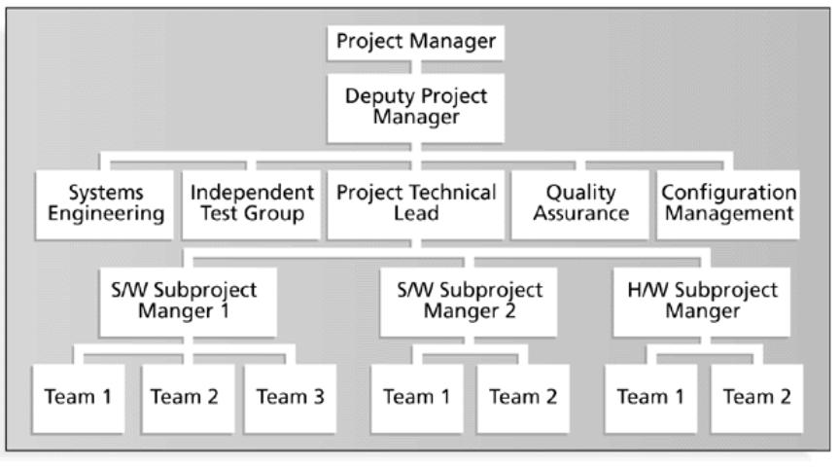
Sample Organizational Chart for an IT Project

Slide 22
Resource Organisation
A program organization chart is essential to allocate staff effectively,
Develop the hierarchical program organization.
Identify Roles and Responsibilities.
Plan for number of staff in each role (at a high level).
Establish Teams.
For each activity identify,
Work amount required (in work units)
Basic skill or experience level required (to even undertake the task)
Complexity of the task (this will help to determine the experience required)
Task Category (Unskilled, skilled, leadership, expert, management)

Slide 23
Role and Responsibility Assignments
Include following:
Role:
Define the accountable person by title
Authority:
Has the authority to assign project resources, make decisions and sign-off
Responsibility:
The work assigned to team member
Competency:
Determines what skill is needed to complete activity
Examining the Staffing Pool
Availability
Ability
Experience
Interest level
Cost
Acquiring the resource
Assembling the team
Developing the team

Slide 24
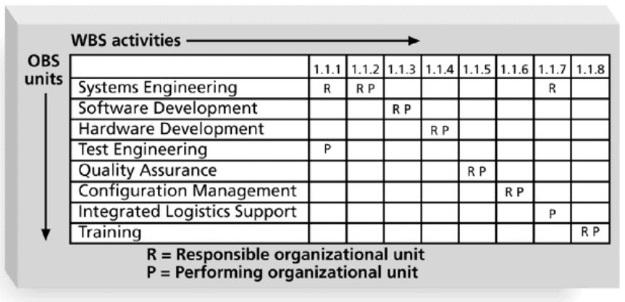
Responsibility Assignment Matrices RAM or RACI Chart
A responsibility assignment matrix (RAM)
A matrix that maps the work of the project as described in the WBS to the people responsible for performing the work as described in the OBS
RAM allocate work to responsible and performing organizations, team or individuals depending on the desired level of details
Notes:
Responsible
Accountable
Consulted
Informed

Slide 25
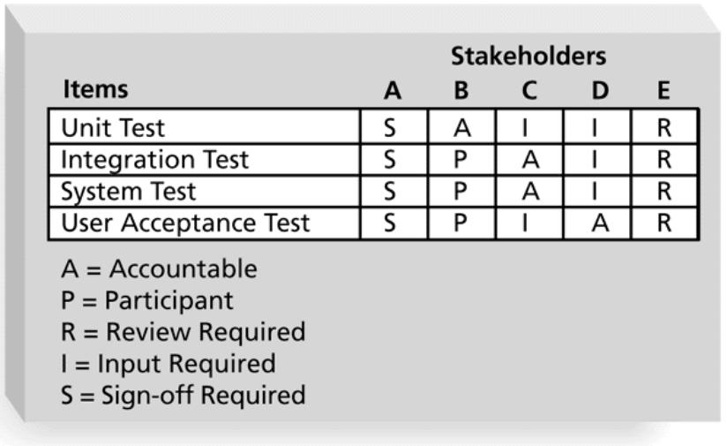
RAM Showing Stakeholder Roles
RAM is also helpful to define the role and responsibilities on project including
the role of the stakeholder in the project i.e accountable or just participant in part of the project
Providing some input, review or sign-off
An effective tool for project manager to communicate roles and responsibilities of important stakeholders

Slide 26
RACI stands for
Responsible- the person who does the work
Accountable- the approver who is accountable for the complete and thorough completion of the task or project
Consulted- the person whose opinion is sought
Informed- The person who is kept up to date

Slide 27
